Slide 1
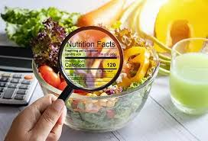
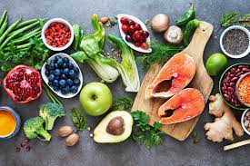

AI Nutritionist
By: Faith, Jared, Kalyani, Ian

Slide 2
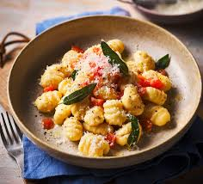
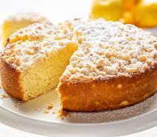
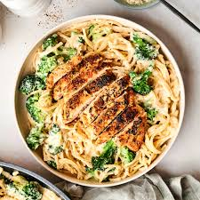
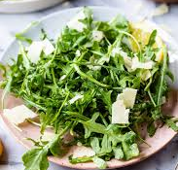
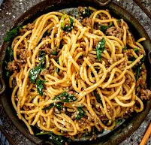
Smart Nutrition Assistant Companion & Curator (S.N.A.C.C.)
Machine Learning Model
Ingredients + Dietary Preference → List of Ranked Recipes
User experience - Fast, easy, intuitive
Utility - Efficient, effective
Output:
Top Recipe Recommendations
User Inputs:
Pantry Inventory
Dietary Preferences (Vegan, Vegetarian, Gluten Free, Dairy Free)
Recommendation Model:
Content-based filtering
Scoring Algorithm

Slide 3
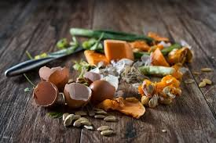
Problem Addressed - Impact of Food Waste on Environment and Economy
40% of food is wasted having a direct impact on the environment and consumption of natural resources (rescuingleftovercuisine.org)
19% of food waste is from retail, food service, and households (moveforhunger.org)
Approximately $243,864,931,645 in food waste per year from America, $728.14 per capita (epa.gov)

Slide 4
Data Collection and Cleanup
INPUT (Dataset Used):
Extended Recipes Dataset: 64K Dishes
https://www.kaggle.com/datasets/wafaaelhusseini/extended-recipes-dataset-64k-dishes
This dataset is an extended and feature-enriched version of the original Recipes Dataset: 64K Dishes(from Kaggle — a high-quality collection of 64,000+ structured recipes.
Transformation Steps:
Data Sanitization: From Raw CSV to Structured Objects e.g.
"[ 'Salt', 'Pepper!' ]" → Clean List: ['salt', 'pepper']
Dropping nulls and duplicates prevents any empty recipes from being recommended.
2. Feature Engineering: Turning Recipes into Vectors e.g. Ingredients + Cuisine + Taste = Combined_Feature
Useful For:
TF-IDF Vectorization
Multi-Label Encoding
Ordinal Mapping

Slide 5
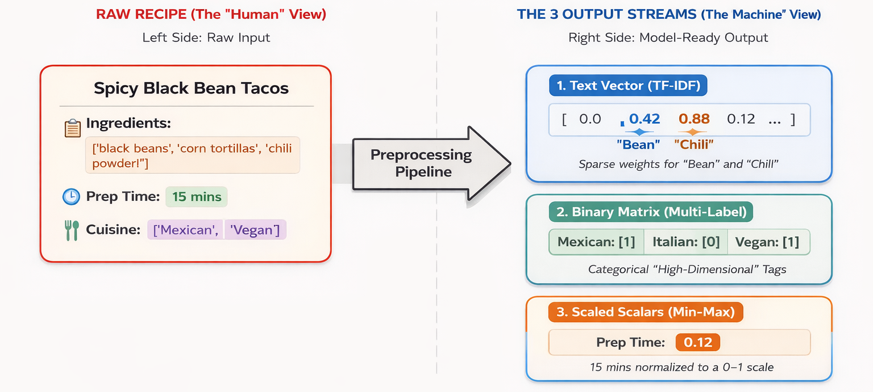
3. Scaling & Integration: Model Readiness & Export Useful For:
Apply MinMax Scaler
The training and testing split
Artifact Export (Saving .pkl files)
OUTPUT (Model-Ready Artifacts):
Cleaned Metadata (.csv)
The Feature Matrix
Fitted Encoders (.pkl)

Slide 6
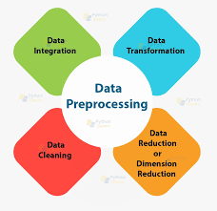
Model
Data Preprocessing for Recipe Recommendation System
Need for Preprocessing
Objective: Prepare raw recipe data for machine learning
Input: recipes_extended.csv
Output: recipes_cleaned.csv
Issues with Raw Data
Ingredients stored as strings instead of lists
Inconsistent text (uppercase, missing values)
Presence of irrelevant columns
Goal
Clean and standardize data
Convert into a machine learning–friendly format

Slide 7
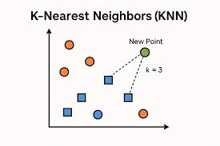
The Model
A content-based recipe recommender
Takes a list of ingredients, a diet, and taste preferences
Returns the recipes most similar to what the user has
No neural network
uses classical ML (TF-IDF + Nearest Neighbors)

Slide 8
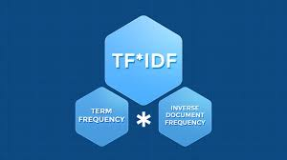
How the Model is Built
Each recipe is converted into a numerical vector using TF-IDF
TF-IDF weights ingredients by how unique they are to each recipe
All recipe vectors are indexed with a Nearest Neighbors model
The trained model is saved so it can be reused without retraining

Slide 9
How the Model is Used
User ingredients are turned into a query vector with the same TF-IDF
Recipes are filtered by dietary preference (vegan, gluten-free, etc.)
Recipes are filtered by up to two taste preferences
Cosine similarity finds the closest matches to the query
The top-N most similar recipes are returned

Slide 10


Impact
Addresses food waste on the individual-level
Economic and environmental impacts
Convenience

Slide 11
Tools Used
Python
main programming language
scikit-learn
TF-IDF vectorizer and Nearest Neighbors model
pandas
loading and handling the recipe data
Streamlit
web interface for trying the model
Kaggle
source of the public recipe dataset
GitHub
code hosting and version control

Slide 12
Future Work
Implementation of User Feedback as Input into Model
Take user opinion on recipes
“Liked it!”, “Disliked it!”, “Hated it!”
Feed user preference information as input into the model
Can be implemented on a recipe basis
Can alternatively be implemented on an ingredient basis
“Anti-Preferences”
Take into account of undesired or unavailable ingredients
Take into account of undesired tastes preferred
Live-search
Query/Scrape the internet for recipe data and fit it into the model

Slide 13
Thank You!

Slide 14
Sources
Real World Application
The Environmental Impact of Food Waste | Move For Hunger
Estimating the Cost of Food Waste to American Consumers
Reducing Wasted Food | Rescuing Leftover Cuisine
U.S. Population (1950-2025)
Scikit-learn Documentation
https://scikit-learn.org/stable/
TF-IDF Vectorizer
https://scikit-learn.org/stable/modules/generated/sklearn.feature_extraction.text.TfidfVectorizer.html
Nearest Neighbors
https://scikit-learn.org/stable/modules/generated/sklearn.neighbors.NearestNeighbors.html

Slide 15
Sources
Web References
Kaggle Datasets – https://www.kaggle.com
Scikit-learn Documentation – https://scikit-learn.org
Streamlit Documentation – https://docs.streamlit.io
Python Official Site – https://www.python.org
GitHub – https://github.com

